Slide 1
Module 5
Matrix representation of graphs- Adjacency matrix, Incidence Matrix, Circuit matrix, Fundamental Circuit matrix and Rank, Cut set matrix, Path matrix.

Slide 2
Matrix Representation of Graphs
Theorem:
If A(G) is an incidence matrix of a connected graph ‘G ‘with ‘n’ vertices, the rank of A(G) is n-1.
Proof
Let G be a connected graph and let A(G) be its incidence matrix.
Now each row in A(G) is a vector over GF(2) in the vector space of graph G.
Let the row vectors be denoted by A1, A2, . . .,An. Then,

Slide 3
Since there are exactly two 1’s in every column of A, the sum of all the vector is 0 (modulo 2 addition of corresponding entries).
Thus A1,A2,…An are not linearly independent.
Therefore the rank of A is less than n.
Clearly, rank A(G) ≤ n−1.

Slide 4
Consider the sum of any m of these row vectors, m ≤ n−1.
Since G is connected, A(G) cannot be partitioned in the form
such that A(G1) has m rows and A(G2) has n−m rows.

Slide 5
Thus there exists no m×m submatrix of A(G) for m ≤n−1, such that the modulo 2 sum of these m rows is equal to zero.
As there are only two elements 0 and 1 in this field, the additions of all vectors taken m at a time for m = 1, 2, . . ., n−1 gives all possible linear combinations of n−1 row vectors.
Thus no linear combinations of m row vectors of A, for m ≤n−1, can be equal to zero.
Therefore rank of A(G) must be at least (n-1).

Slide 6
Since the rank of A(G) is no more than (n-1) and is no less than (n-1), it must be exactly equal to (n-1), Hence the theorem.
Remark: If G is a disconnected graph with k components, then it follows from the above theorem that rank of A(G) is n−k.

Slide 7
Reduced incidence matrix
Let G be a connected graph with n vertices and m edges. Then the order of the incidence matrix A(G) is n×m.
Now, if we remove any one row from A(G), the remaining (n−1) by m submatrix is of rank (n−1). Thus the remaining (n−1) row vectors are linearly independent.
This shows that only (n−1) rows of an incidence matrix are required to specify the corresponding graph completely, because (n−1) rows contain the same information as the entire matrix.

Slide 8
This follows from the fact that given (n−1) rows, we can construct the nth row, as each column in the matrix has exactly two ones.
Such an (n−1) × m matrix of A is called a reduced incidence matrix and is denoted by A_{f}. The vertex corresponding to the deleted row in A_{f} is called the reference vertex.

Slide 9
Theorem:
The reduced incidence matrix of a tree is non-singular.
Proof
A tree with n vertices has n−1 edges and also a tree is connected. Therefore, the reduced incidence matrix of a tree is a square matrix of order n−1, with rank n−1. Thus the result follows. (It can not be reduced to a row reduced or column reduced matrix. So determinant of this matrix can not be zero. So it is non singular.)
Now a graph G with n vertices and n −1 edges which is not a tree is obviously disconnected.
Therefore the rank of the incidence matrix of G is less than (n−1).
Hence the (n−1)×(n−1) reduced incidence matrix of a graph is non-singular if and only if the graph is a tree.

Slide 10
Submatrices of A(G)
Let H be a subgraph of a graph G, and let A(H) and A(G) be the incidence matrices of H and G respectively.
Clearly, A(H) is a submatrix of A(G), possibly with rows or columns permuted.
We observe that there is a one-one correspondence between each n×k submatrix of A(G) and a subgraph of G with k edges, k being a positive integer, k < m and n being the number of vertices in G.

Slide 11
Theorem :
Let A(G) be the incidence matrix of a connected graph G with n vertices. An (n−1)×(n−1) submatrix of A(G) is non-singular if and only if the n−1 edges corresponding to the n−1 columns of this matrix constitutes a spanning tree in G.

Slide 12
Circuit Matrix
Let the number of different circuits in a graph G be ‘q’ and the number of edges in G be ‘e’. Then a circuit matrix B=[b_{ij}] of G is a q by e,(0,1) - matrix defined as follows:
b_{ij} = 1, if i^{th} circuit includes j^{th} edge, and
= 0 , otherwise.
The circuit matrix of a graph G is usually denoted as B(G).

Slide 15
Observations on Circuit Matrix
A column of all zeros corresponds to a non circuit edge(ie an edge that does not belong to any circuit).
Each row of B(G) is a circuit vector.
Unlike the incidence matrix the circuit matrix will be capable of representing a self-loop – the corresponding row will have a single 1.
The number of 1’s in a row is equal to the number of edges in the corresponding circuit.
If a graph G is disconnected( or separable) and consists of two components (or blocks) g1 and g2

Slide 16
the circuit matrix B(G) can be written in a block diagonal form as
where B(g1) and B(g2) are the circuit matrices of g1 and g2. This observation results from the facts that circuits in g1 have no edges belonging to g2, and vice versa.
Permutation of any two rows or columns in the circuit matrix simply corresponds to relabelling the circuits and edges.

Slide 17
Two graphs G1 and G2 will have the same circuit matrix if and only if G1 and G2 are 2-isomorphic.
Theorem:
Let B and A be, respectively the circuit matrix and the incidence matrix (of a self-loop free graph) whose columns are arranged using the same order of edges. Then every row of B is orthogonal to every row of A.
ie A.B^{T} = B.A^{T}, where superscript T denotes the transposed matrix.
Proof:
Consider a vertex v and a circuit ┌ in the graph G.

Slide 18
Either v is in ┌ or it is not. If v is not in ┌ , there is no edge in the circuit ┌ that is incident on v.
On the other hand , if v is in ┌ , the number of those edges in the circuit ┌ that are incident on v is exactly two.
Now consider i^{th} row in A and j^{th} row in B. Since the edges are arranged in the same order, the non-zero entries in the corresponding positions occur only if the particular edge is incident on the i^{th} vertex and and is also in the j^{th} circuit.

Slide 19
If the i^{th} vertex is not in the j^{th} circuit , there is no such nonzero entry, and the dot product of the two rows is zero.
If the i^{th} vertex is in the j^{th} circuit, there will be exactly two 1’s in the sum of products of individual entries.
Since 1 + 1= 0(mod2), the dot product of the two arbitrary rows – one from A and the other from B is –zero. Hence the theorem.

Slide 20
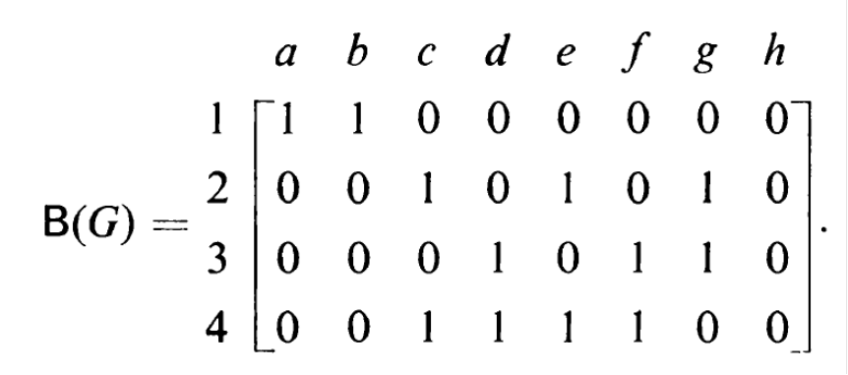

Slide 23
Fundamental Circuit Matrix and Rank of B
The fundamental circuits with respect to any spanning tree in a connected graph are the only independent circuits in a graph.
The rest of the circuits can be obtained by the linear combination (ring sums) of these circuits.
Thus in a circuit matrix if we retain only those rows that correspond to a set of fundamental circuits and remove all other rows, we would not lose any information.

Slide 24
Here a graph and its spanning tree(indicated in thick lines) are shown
Fundamental circuits are
circuit 1:- e1-e2-e4-e7
circuit 2:- e3-e4-e7
circuit 3- e5-e6-e7

Slide 25
circuit 4:-e1-e2-e3
circuit 5:-e1-e2-e4-e5-e6
circuit 6:- e3-e4-e5-e6
A submatrix of a circuit matrix in which all rows correspond to a set of fundamental circuits is called fundamental circuit matrix B_{f}.
If n is the number of vertices and e is the number of edges in a connected graph then, B_{f} is a (e-n+1) by e matrix, because the number of fundamental circuits is (e-n+1),(each fundamental circuit being produced by one chord).

Slide 26
In B_{f} columns are arranged such that all e-n+1 chords correspond to the first e-n+1 columns.
Rows are arranged such that first row correspond to the fundamental circuit made by the chord in the first column, the second row to the fundamental circuit made by the second and, so on.

Slide 27
A matrix B_{f} thus arranged can be written as

Slide 28
Theorem: If B is a circuit matrix of connected graph G with e edges and n vertices,
rank of B = e-n+1
Proof
If A is an incidence matrix of G, we have
A. B^{T}= 0 (mod 2)
Therefore according to Sylvester’s theorem
rank of A + rank of B ≤ e

Slide 29
ie rank of B ≤ e- rank of A.
We know that rank of A = n-1.
Then rank of B ≤ e-n+1
But we know that rank of B ≥ e-n+1
Therefore we must have rank of B =e-n+1

Slide 30
Alternative Proof
Consider the circuit space W_{r} in the vector space W_{G} of a graph.
Every row in circuit matrix B is a vector in W_{r}, and since the rank of any matrix is equal to number of linearly independent rows in the matrix,
we have rank of matrix B= number of linearly independent rows in B.
But the number of linearly independent rows in B ≤ number of linearly independent vectors in W_{r}.
Number of linearly independent vectors in W_{r} = dimension of W_{r} = µ

Slide 31
Therefore rank of B ≤ e-n+1
But we have the result B ≥ e-n+1
Therefore rank of B must be e-n+1.
If G is a disconnected graph with k components e edges and n vertices, then rank of B = e-n+k.

Slide 32
Path matrix
A path matrix is defined for a specific pair of vertices in a graph say (x,y), and is written as P(x,y).
The rows in P(x,y) corresponds to different paths between vertices x and y, and the columns corresponds to the edges in G.
ie, the path matrix for (x,y) vertices is P(x,y) = [p_{ij}], where
p_{ij} = 1, if j^{th} edge is in i^{th} path.
= 0, otherwise.

Slide 33
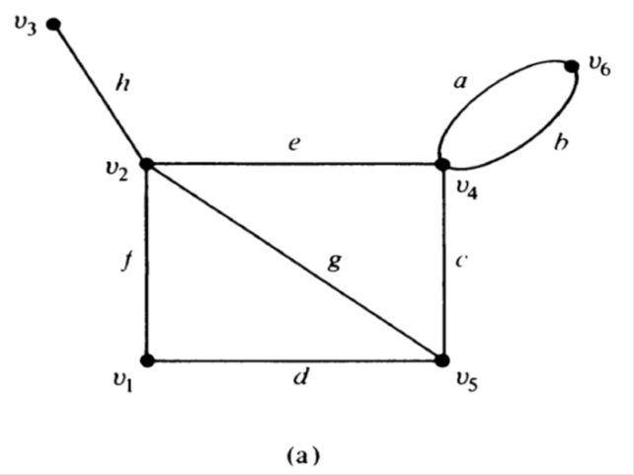
Consider the graph
Consider the path between v3 and v4. There are 3 different paths.
{h,e}, {h,g,c}, {h,f,d,c}

Slide 34
We get a 3x8 path matrix P(v3,v4) as:

Slide 35
Observations on a path matrix P(x,y) of a graph G are:
A column of all 0’s corresponds to an edge that does not lie in any path between x and y.
A column of all 1’s corresponds to an edge that lie in every path between x and y.
There is no row with all 0’s.
The ring sum of any two rows in P(x,y) corresponds to a circuit or an edge disjoint union of circuits.

Slide 36
Theorem 7-7 Home work.

Slide 37
Adjacency Matrix
The adjacency matrix of a graph G with n vertices and no parallel edges is an n by n symmetric binary matrix X= [x_{ij}] defined over the ring of integers such that
xij = 1, if there is an edge between i^{th} and j^{th} vertices
= 0, if there is no edge between them

Slide 39
Observations made on adjacency matrix X of a graph G are:
1. The entries along the principal diagonals are all 0’s if and only if the graph has no self loops. A self loop at i^{th} vertex corresponds to x_{ii}=1.
The definition of adjacency matrix makes no provision for parallel edges. This why the adjacency matrix X was defined for graphs without parallel edges.
If the graph has no self loops, the degree of a vertex equals the number of 1’s in the corresponding rows or columns of the matrix.

Slide 40
Permutations of rows and columns imply reordering of vertices. Rows and columns must be arranged in same order. Thus if two rows are interchanged in X , the corresponding columns must also be interchanged.
Hence two graphs G1 and G2 are isomorphic iff their adjacency matrices X(G1) and X(G2) are related:
X(G2) = R⁻¹.X(G1).R, where R is a permutation matrix.
A graph G is disconnected and is in two components g1 and g2 if and only if its adjacency matrix X(G) can be partitioned as

Slide 41
Where X(g1) is the adjacency matrix of component g1 and X(g2) is the adjacency matrix of component g2.
This partitioning clearly implies that there exists no edge joining any vertex in subgraph g1 to any vertex in subgraph g2.
Given any square, symmetric binary matrix Q of order n, one can always construct a graph G of n vertices such that Q is the adjacency matrix of G.

